Slide 1
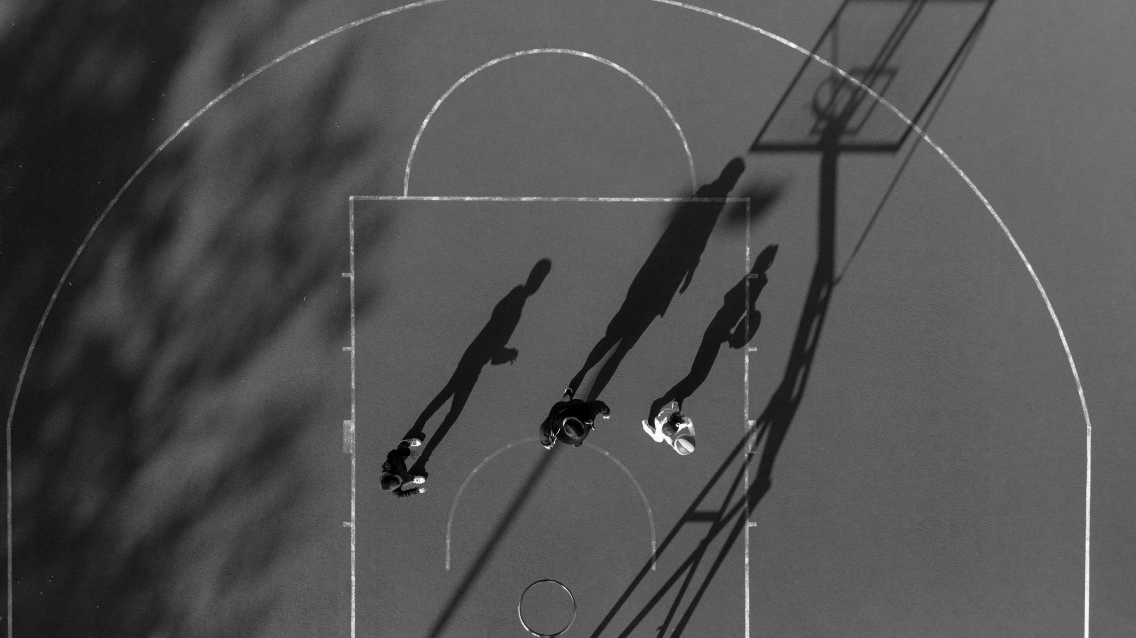
Predicting FG% for NBA Players
04/12/2025
Vivek Divakarla

Slide 2
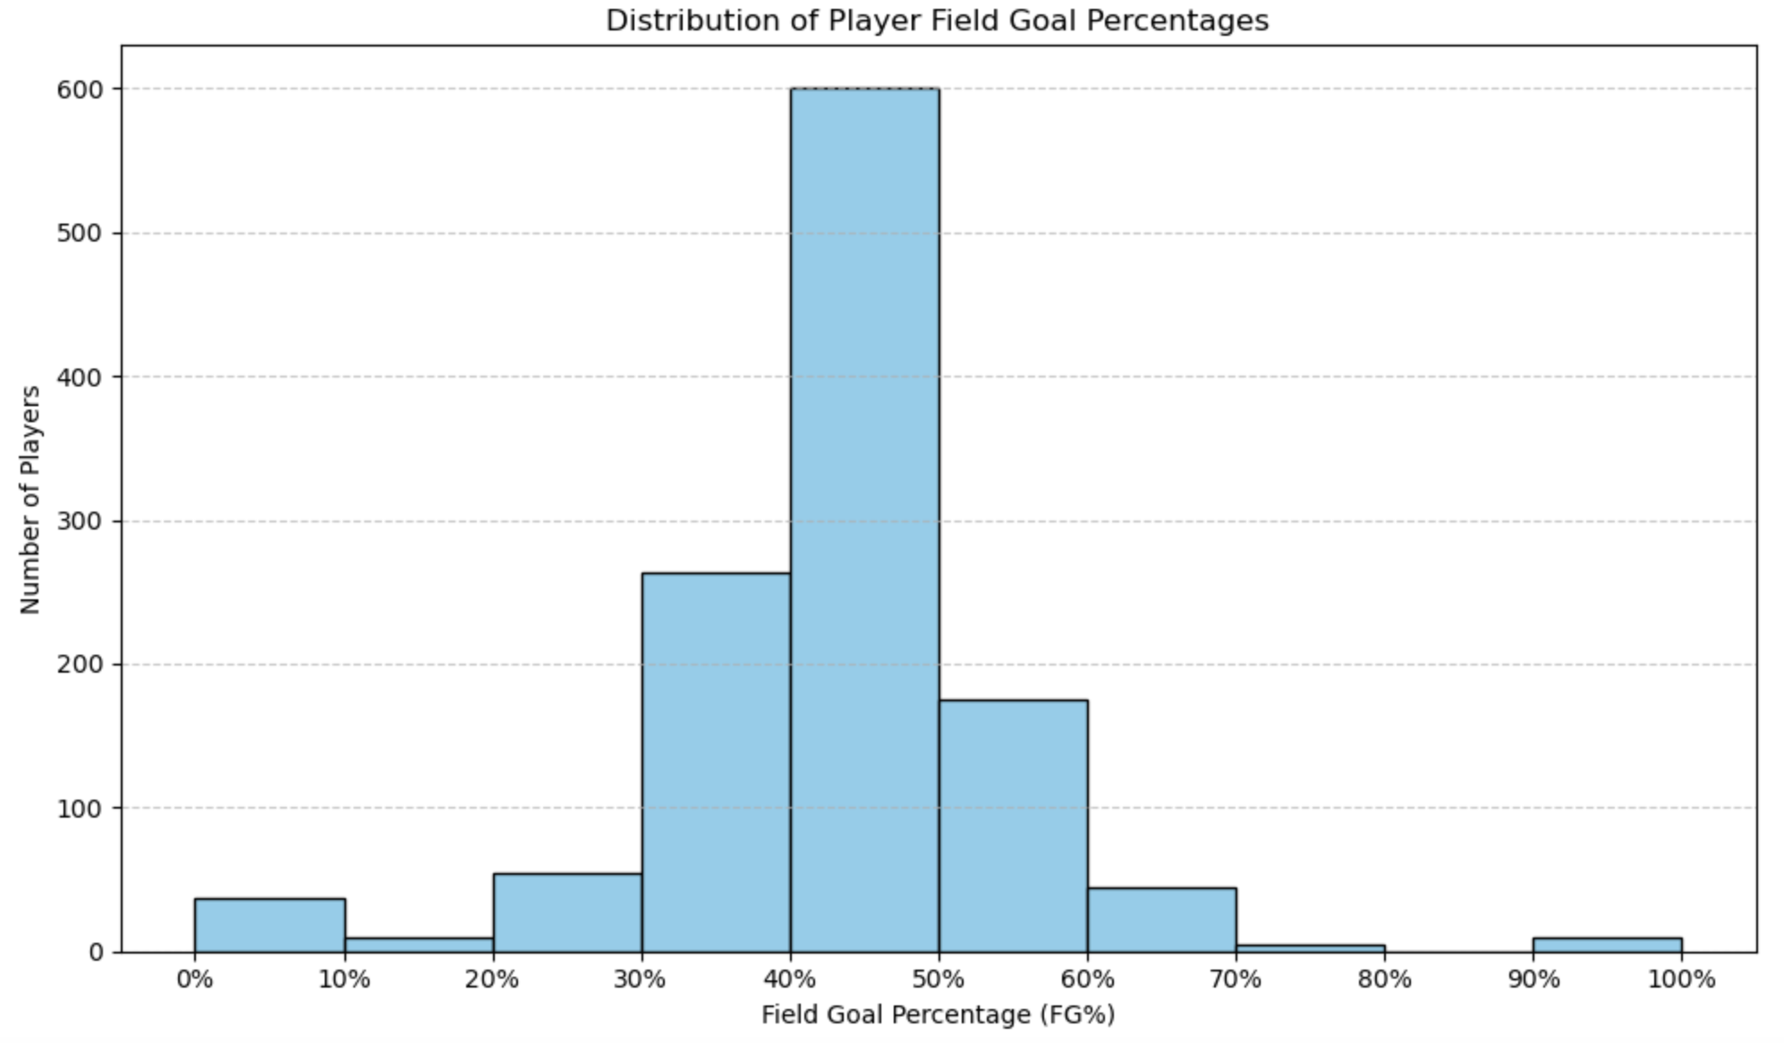
Exploratory Data Analysis
Training Dataset Metrics:
1200 Unique Players
30 Unique Teams
7 Seasons of Data (2018-2024)

Slide 3
Methods to Predict FG%
Assign Season Weights
Later seasons weighted more heavily
Reflects emphasis on recent performance
Compute weighted averages for players on:
Shot Distance
Shot Location
% of Shots that are 3Pointers
Compute weighted FG% (target variable)
Build and train model
Filter out players with < 50 FGA
Train RandomForestRegressor

Slide 4
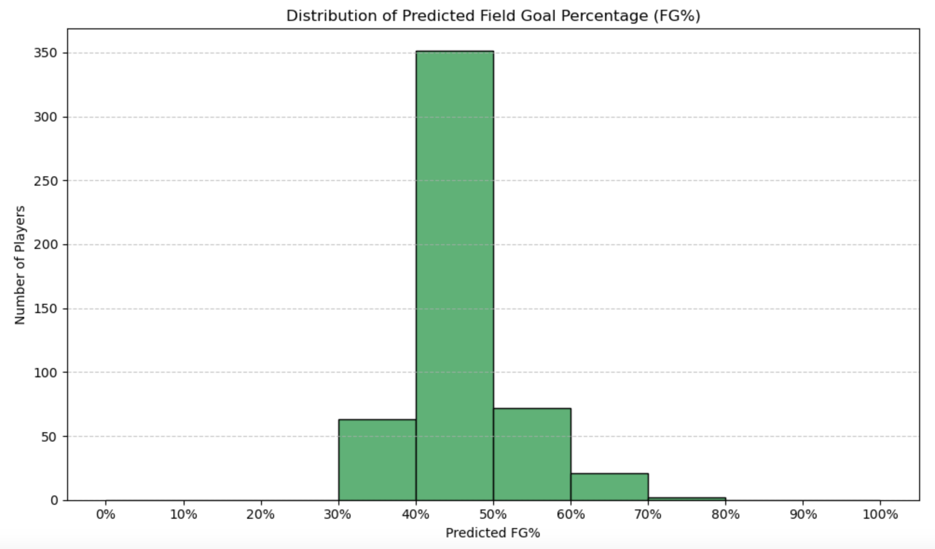
Results

